Slide 1
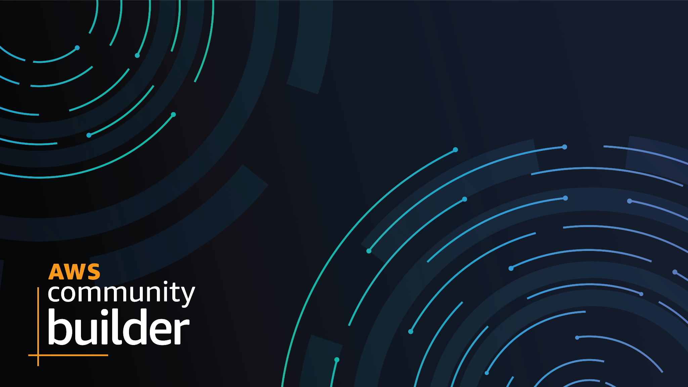
How to start serverless?
Shaista Aman - Pakistan CB Q1 2022
Muhammad Shakeel User Group Member

Slide 2
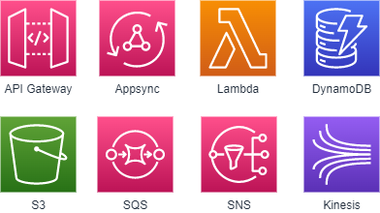
Serverless…
Serverless is a cloud-native development model that allows developers to build and run applications without having to manage servers.
Why Serverless?
Serverless architectures offer
greater scalability
more flexibility
Never pay for idle
quicker time to release, all at a reduced cost.
AWS Serverless Services
Notes:
With serverless architectures, developers do not need to worry about purchasing, provisioning, and managing backend servers.

Slide 3
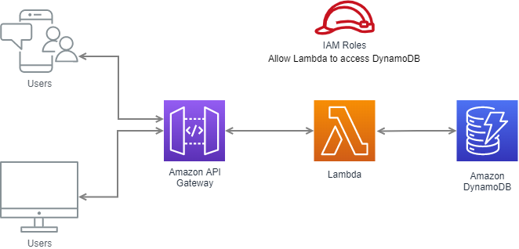
Mini Serverless Architecture

Slide 4
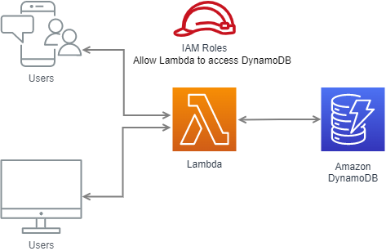
Lambda with Function URL

Slide 5
Thank You
Shaista Aman - Pakistan CB Q1 2022

